Slide 1
Exploring identity online
Assembly for ages 7-11
Notes:
Freepik- doodles
Freepik - Images of children

Slide 2
What makes me… me?
Notes:
Noun project, Shuttertock - images

Slide 3
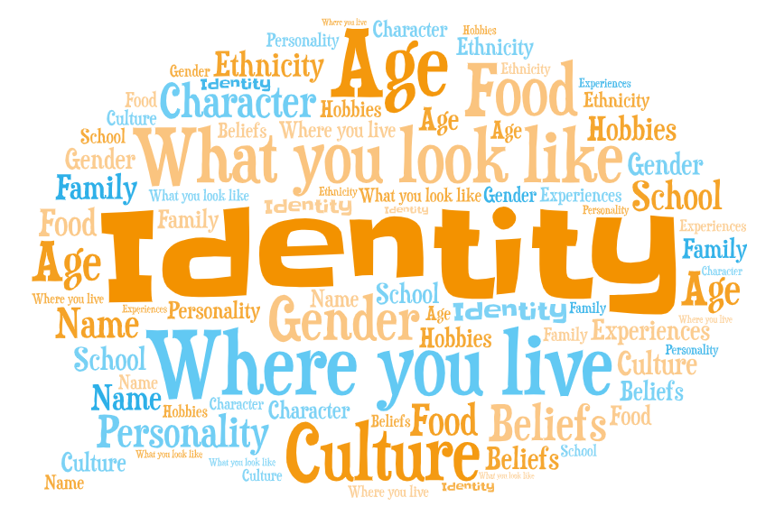
Notes:
https://emojipedia.org – Emoji head

Slide 4
Have you ever…

Slide 5
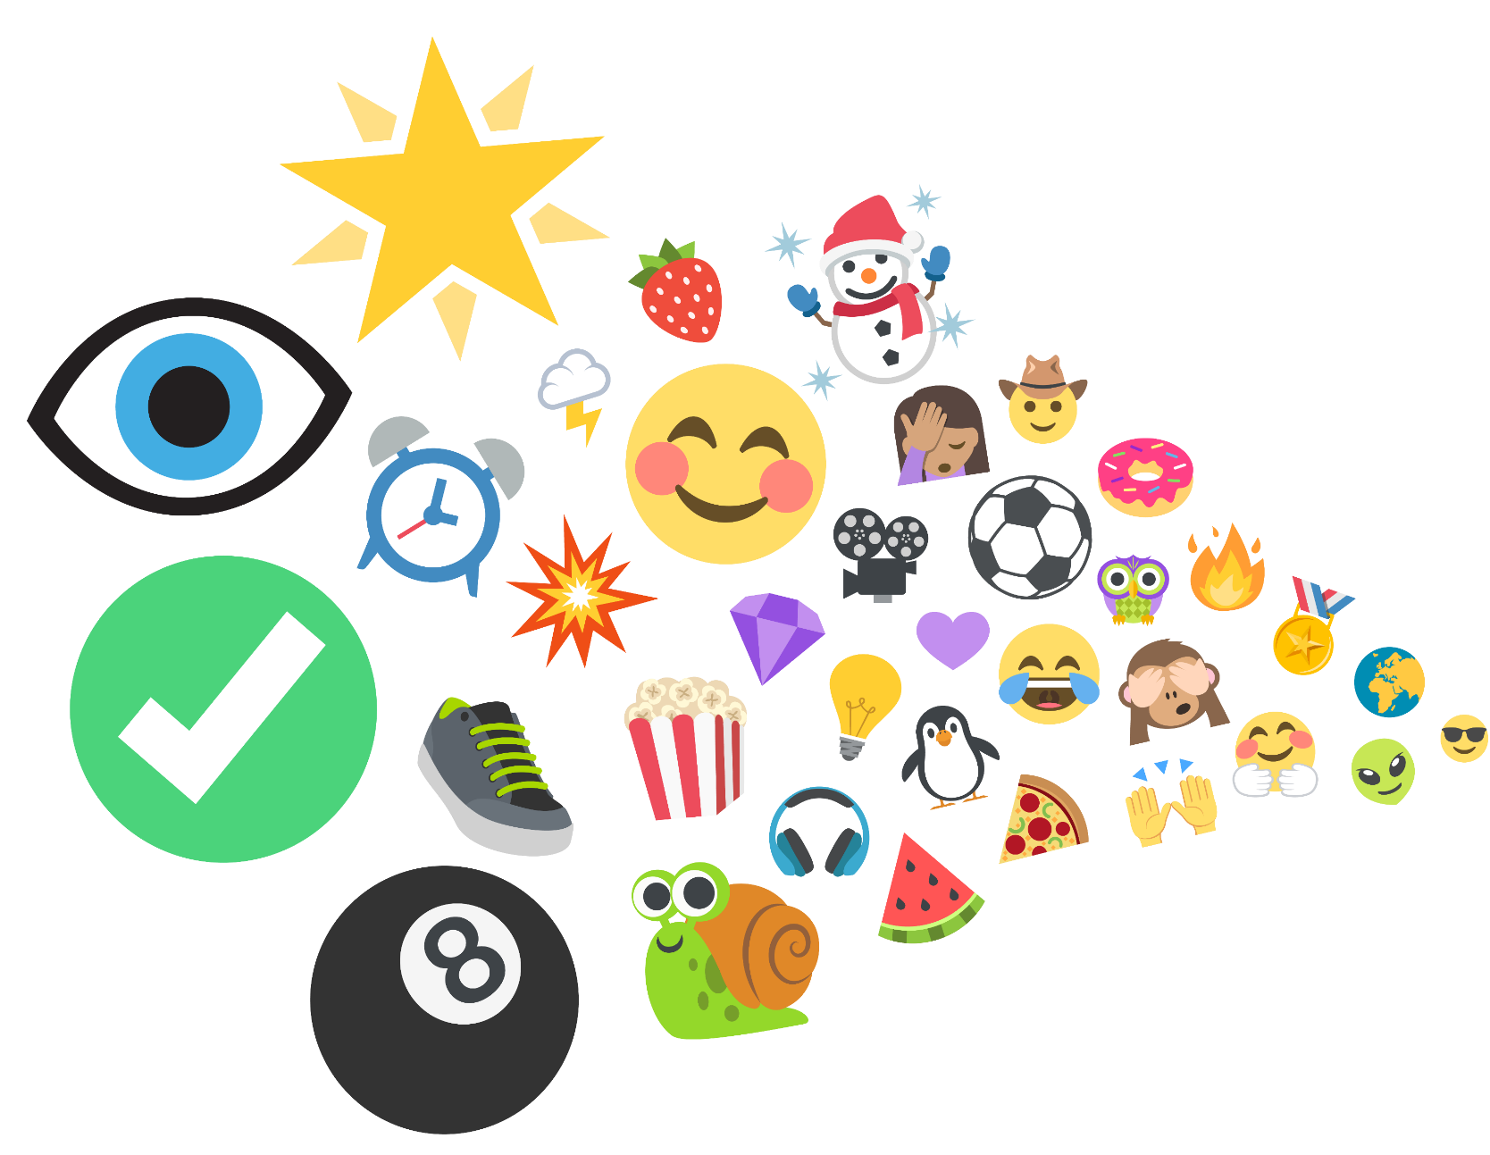
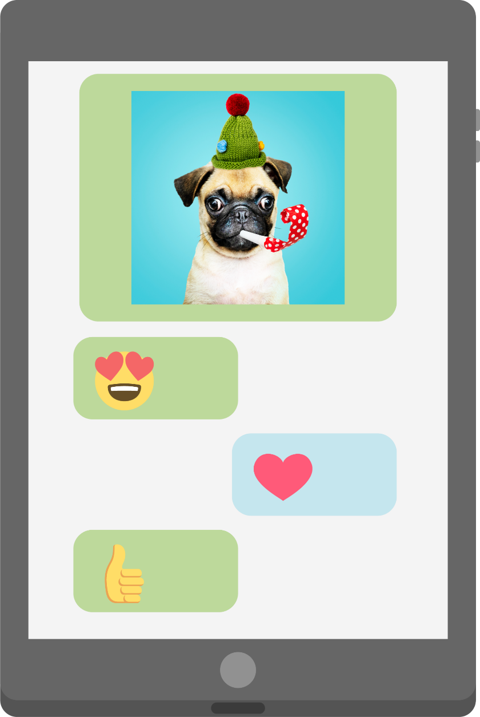
…seen or used an emoji?
Notes:
Shutterestock – tablet
Freepik – dog photo
Emojis from-
https://www.joypixels.com/emoji#all

Slide 6
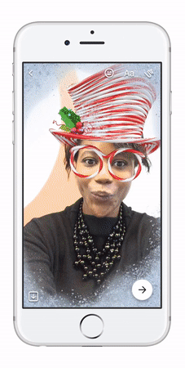
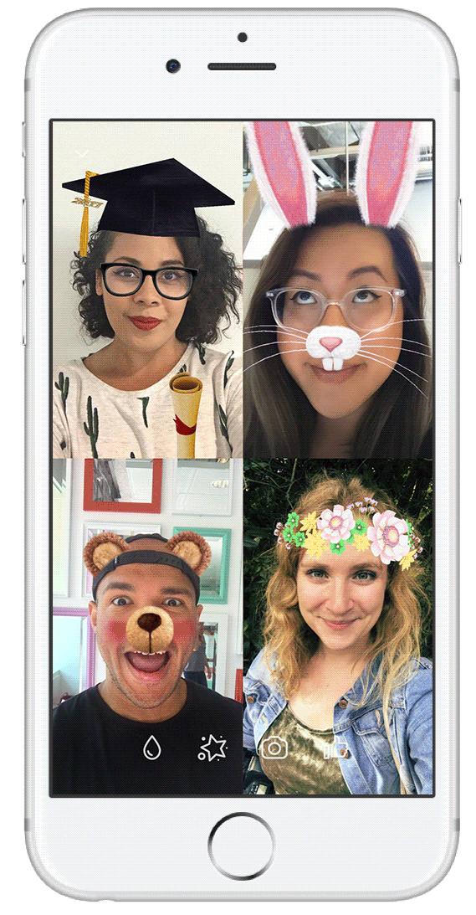
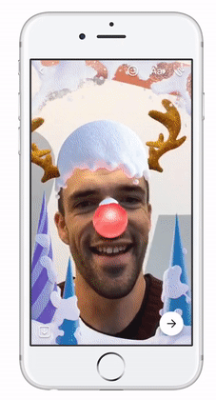
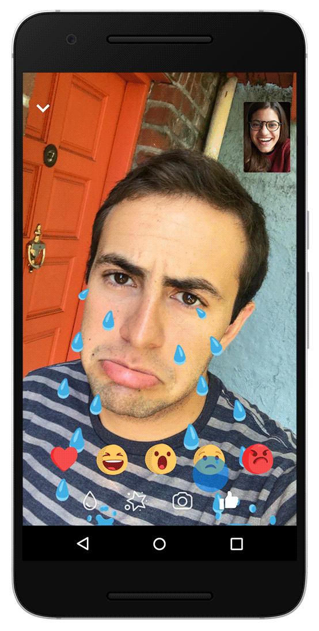
…used a filter online?
Notes:
© Facebook

Slide 7
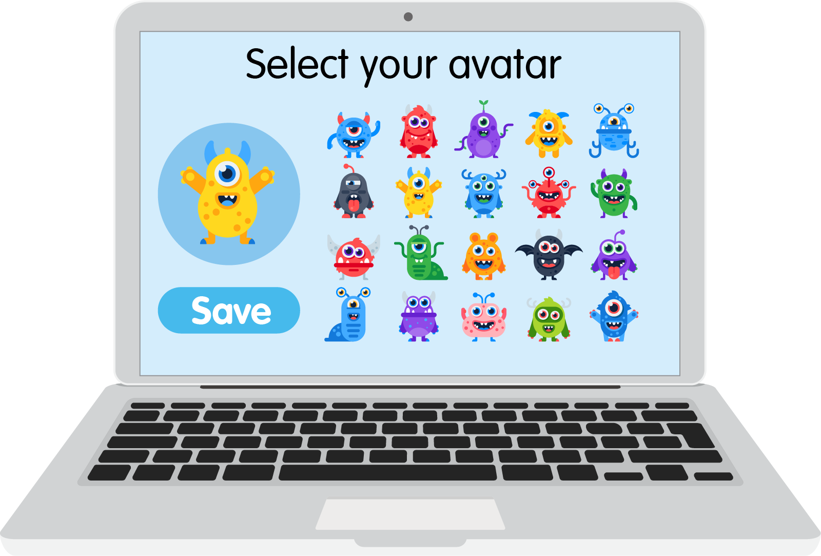
… created or chosen an avatar or character?

Slide 8
Username | Online
Gamer_girl467 | Yes
Jo.pizzaboss.73- | Yes
sleepy_meerkat | No
_Flying.fox.55 | Yes
mega.Millie | No
Invisible_penguin23 | No
xX-PLY2WIN-Xx | No
lucky-dimond.01 | No
…chosen a username?

Slide 9
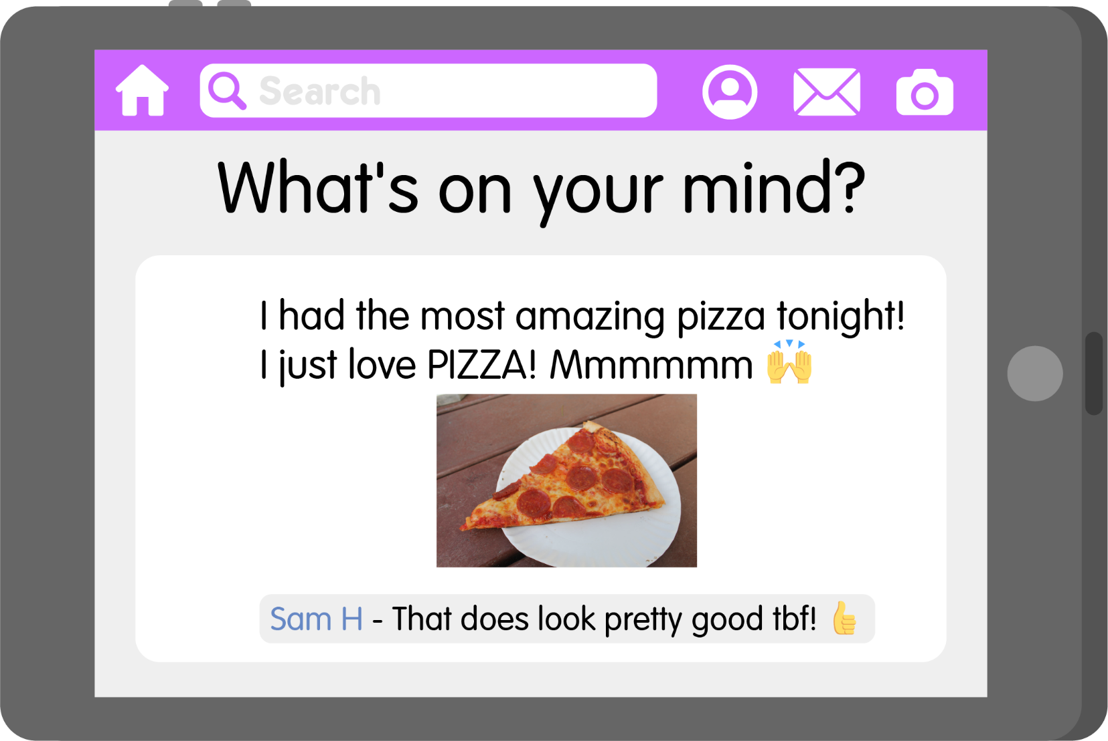
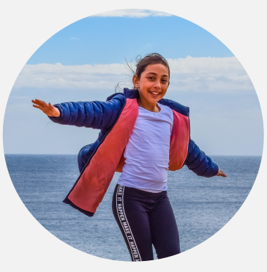
… shared something online about yourself or the things you like to do?

Slide 10
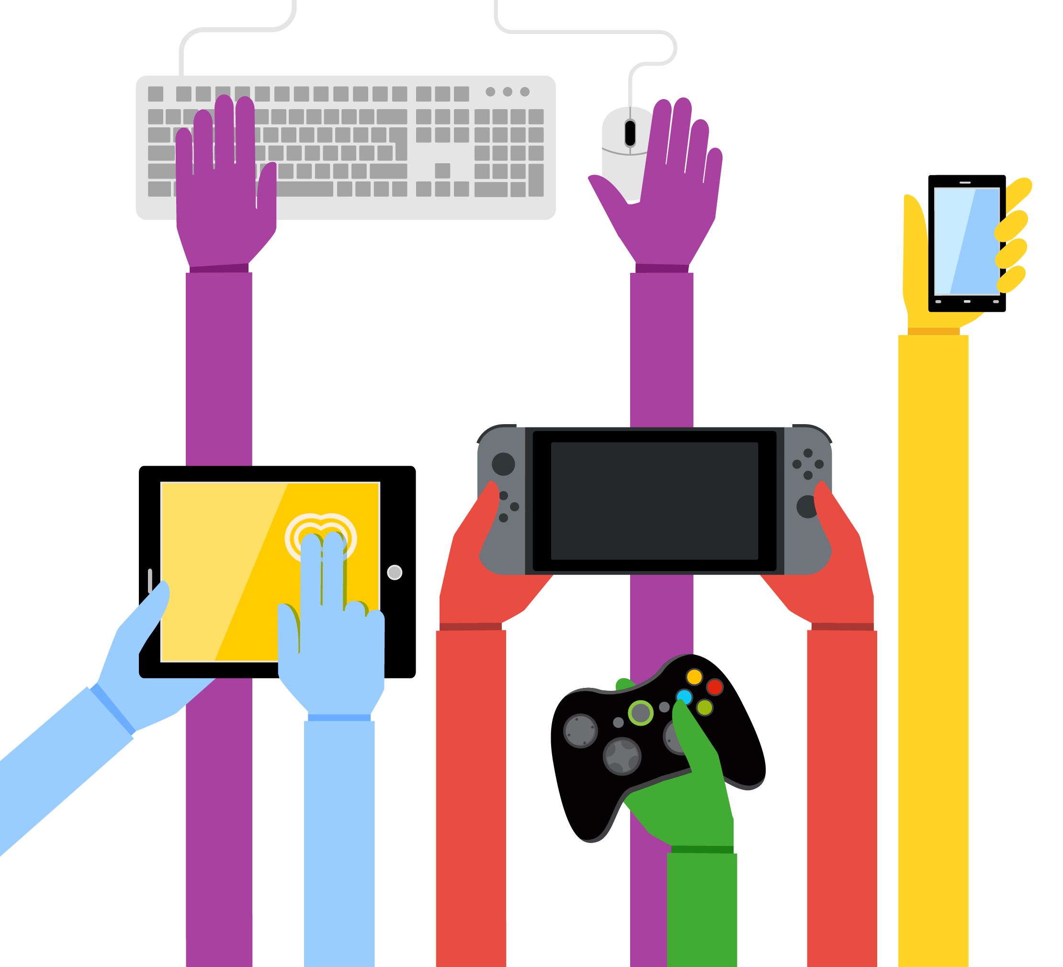
People all over the world use the internet.
So there are lots of different identities online.
58% of people go online!

Slide 11
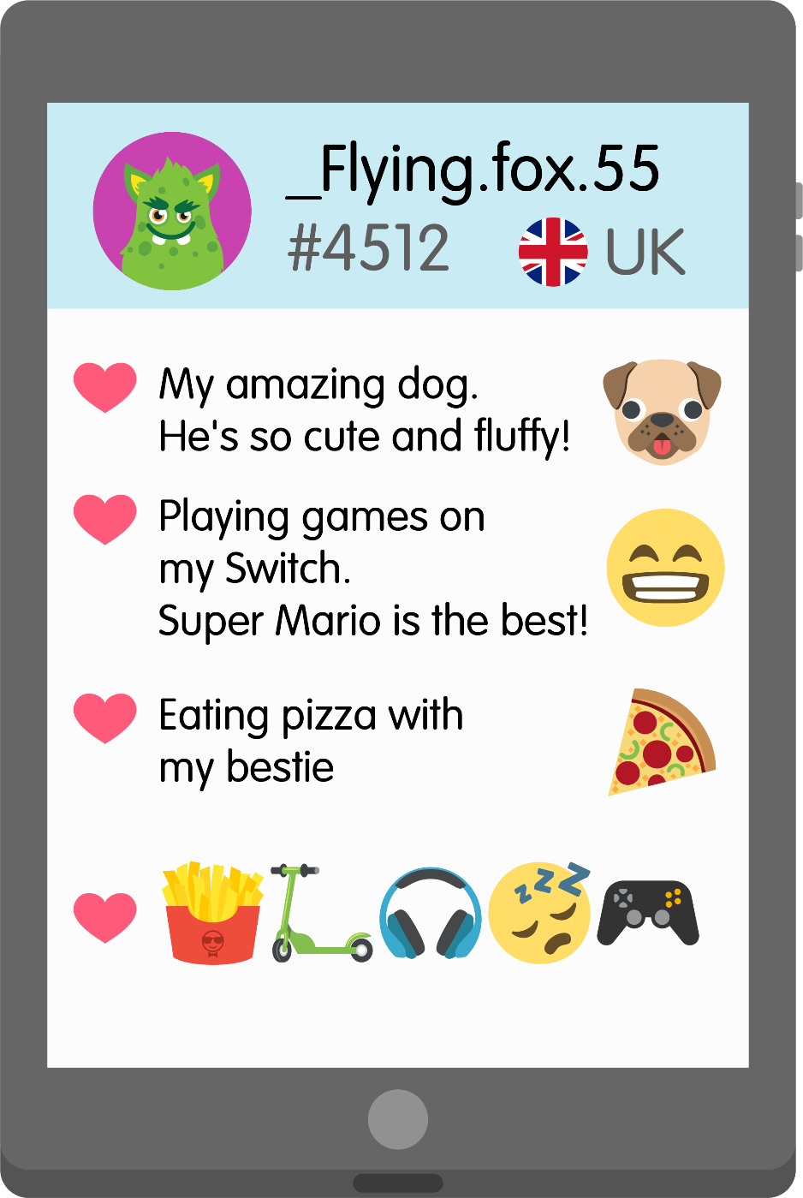
Online identity detectives

Slide 12
There are lots of positive things about changing our identity online:
It can help keep you safe.
You can express yourself.
You can be creative.
It can be really fun!

Slide 13
Always speak to an adult if…
Someone else online has worried or upset you.
You are ever unsure about something you’ve shared online about your identity.
Someone else online has asked you for your personal information or for photos or videos of you.

Slide 14
“I can do whatever I want online, and I can’t get into trouble because it’s my online identity talking not me.”

Slide 15
What have you learnt about online identities today?

